Slide 1
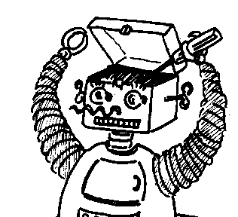
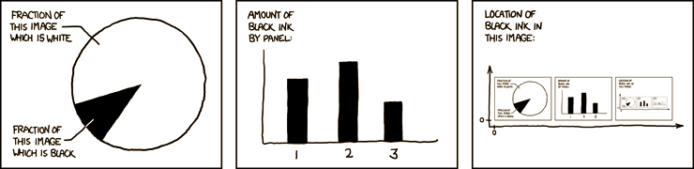

Maryland Metacognition Seminar
http://xkcd.com/
Metamodel for personalized adaptation of pedagogical strategies using metacognition in Intelligent Tutoring Systems
Manuel Caro
Department of Educational Informatics, Universidad de Córdoba, Montería - Colombia
6 September 2013, 12:00 PM
A.V. Williams Bldg., RM. 3258, College Park
Abstract:
The modeling process of Intelligent Tutoring Systems (ITS) is often difficult and time consuming. In particular the design process of the pedagogical strategies in ITS is complex and requires the interaction of a number of variables that define it as a dynamic process. The ITS design process becomes more complex when the integration of several metacognitive components such as self-regulation and metamemory to improve ITS performance are required. To overcome these types of problems, this work proposes a metamodel-based approach to the integration of metacognitive capacities in ITS. The metamodel increases the level of automation all along the development process due to the metamodel defining the language, structure and transformation rules to be used for the design of different types of models. The proposed metamodel is based on the standard Meta Object Facility (MOF) of Model-Driven Architecture (MDA).

